Slide 1
SW Project Management
Target group: Software Engineering 3rd year students
Instructor: Azmeraw Dessalegn

Slide 2
Chapter one
Introduction

Slide 3

Management Spectrum
Effective software project management focuses on the four main element of management, the 4 P’s:
People — the most important element of a successful project
Product — the software to be built
Process — the set of framework activities and software engineering tasks to get the job done
Project — all work required to make the product a reality
The manager has to give equal attention on each (manager has to know all attributes in each P’s)

Slide 4

Effective SW Project Management focuses on the 4 P’s
Product
People
Process
Project

Slide 5
Why need to study SPM?
The €339 million United Kingdom air traffic control system was reported as being two years behind schedule;
A 1995 Standish Group study (CHAOS) found that only 16.2% of IS projects were successful and over 31% were canceled before completion, costing over $81 B in the U.S. alone.
Worldwide cost of IT failure (revisited): $3 trillion

Slide 6
Causes of Project Management Failure
Bad Communications
Poor schedule or resource Management (mismanagement)
Weak requirements definitions (leads to inadequate planning)
Inadequate planning, assumptions, risks, or resources
Use of new or unproven technologies/methods

Slide 7
Causes of Project Management Failure
Ineffective (or nonexistent) quality controls
Managing multiple projects at once or multi-tasking resources
Supply chain failures
Scope creep or poor impact analysis
Lack of qualified resources

Slide 8
Advantages of Using Formal SPM
Better control of financial, physical, and human resources
Improved customer relations
Shorter development times
Lower costs

Slide 9
Advantages of Using Formal SPM
Higher quality and increased reliability
Higher profit margins
Improved productivity
Better internal coordination
Higher worker morale

Slide 10
Software engineering and project management: What is software?
Computer programs and associated documentation such as requirements, design models and user manuals.
Software products may be developed for a particular customer or may be developed for a general market.
Software products may be
Generic - developed to be sold to a range of different customers e.g. PC software such as Excel or Word.
Bespoke (custom) - developed for a single customer according to their specification.
New software can be created by developing new programs, configuring generic software systems or reusing existing software.

Slide 11
What is software engineering?
Software engineering is an engineering discipline that is concerned with all aspects of software production.
Software engineers should adopt a systematic and organised approach to their work and use appropriate tools and techniques depending on the problem to be solved, the development constraints and the resources available.

Slide 12
What is a software process?
A set of activities whose goal is the development or evolution of software.
Generic activities in all software processes are:
Specification - what the system should do and its development constraints
Development - production of the software system
Validation - checking that the software is what the customer wants
Evolution - changing the software in response to changing demands.

Slide 13
The Nature of Software
Software is intangible
Hard to understand development effort
Software is easy to reproduce
Cost is in its development
in other engineering products, manufacturing is the costly stage
The industry is labor-intensive
Hard to automate

Slide 14
The Nature of Software ...
Untrained people can hack something together
Quality problems are hard to notice
Software is easy to modify
People make changes without fully understanding it
Software does not ‘wear out’
It deteriorates by having its design changed:
erroneously, or
in ways that were not anticipated, thus making it complex

Slide 15
The Nature of Software
Conclusions
Much software has poor design and is getting worse
Demand for software is high and rising
We are in a perpetual ‘software crisis’
We have to learn to ‘engineer’ software

Slide 16
Software Quality and the Stakeholders
Customer:
User:
solves problems at
easy to learn;
an acceptable cost in
efficient to use;
terms of money paid and
helps get work done
resources used
QUALITY
SOFTWARE
Developer:
Development manager:
easy to design;
sells more and
easy to maintain;
pleases customers
easy to reuse its parts
while costing less
to develop and maintain

Slide 17
Challenges in Software projects /SE (calls for specializations
Software
Was full of error
Could not be maintained
Was not delivered on time
Did not meet requirements
Software Systems are Complex
Many functions, participants, components
Software development projects are subject to change
Users requirements are dynamic

Slide 18
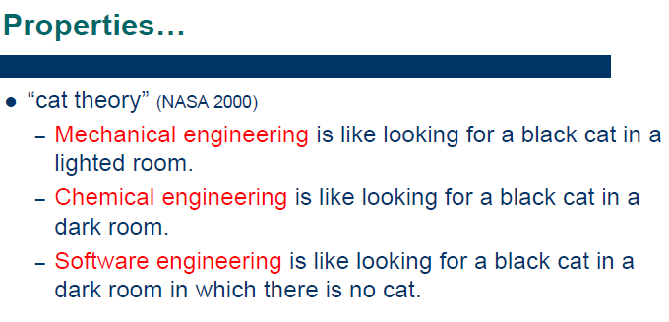

Slide 19
Specializations - software engineering
Software engineering can be divided into 9 sub-disciplines:
Software requirements
The elicitation, analysis, specification, and validation of requirements for software.
Software design
The design of software is usually done with Computer-Aided Software Engineering (CASE) tools and use standards for the format, such as the Unified Modeling Language (UML).
Software development
The construction of software through the use of programming languages.

Slide 20
Cont…
Software testing
Software Testing is an empirical investigation conducted to provide stakeholders with information about the quality of the product or service under test, with respect to the context in which it is intended to operate.
Software maintenance
Software systems often have problems and need enhancements for a long time after they are first completed. This subfield deals with those problems.
Software configuration management
Since software systems are very complex, their configuration (such as versioning and source control) have to be managed in a standardized and structured method.

Slide 21
Cont…
Software project management
The management of software systems projects borrows heavily from project management, but there are nuances encountered in software not seen in other management disciplines.
Software development process
is a structure imposed on the development of a software product.
Software quality
measures how well software is designed (quality of design), and how well the software conforms to that design (quality of conformance)

Slide 22
Costs of software projects
Roughly 60% of costs are development costs, 40% are testing costs. For custom software, evolution costs often exceed development costs.
Costs vary depending on the type of system being developed and the requirements of system attributes such as performance and system reliability.
Distribution of costs depends on the development model and project management that is used.

Slide 23
What is a Project?
A project is a temporary endeavor undertaken to create a unique product or service.

Slide 24
Attributes of projects
unique purpose
temporariness
require resources, often from various areas
should have a primary sponsor and/or customer
involve uncertainty

Slide 25
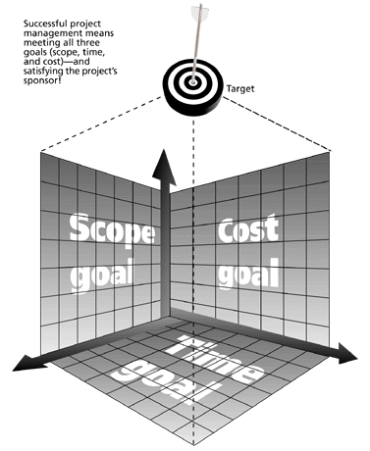
The Triple Constraint
Every project is constrained in different ways by its
Scope goals: What is the project trying to accomplish?
Time goals: How long should it take to complete?
Cost goals: What should it cost?
It is the project manager’s duty to balance these three often competing goals

Slide 26
What is Project Management?
Project management is “the application of knowledge, skills, tools, and techniques to project activities in order to meet project requirements.” (PMI*)
Project Management is the discipline of planning, organizing, and managing resources to bring about the successful completion of specific project goals and objectives.
*The Project Management Institute (PMI) is an international professional society. Their web site is www.pmi.org.

Slide 27
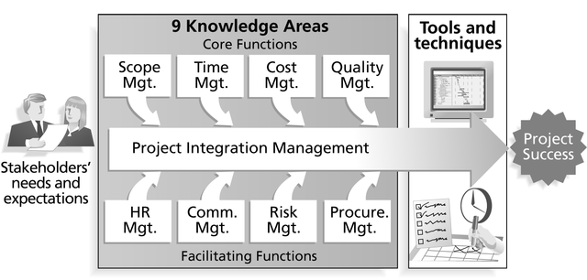
Project Management Framework

Slide 28
Project Stakeholders
Stakeholders are the people involved in or affected by project activities
Stakeholders include
the project sponsor and project team
support staff
customers
users
suppliers
opponents to the project

Slide 29
9 Project Management Knowledge Areas
Knowledge areas describe the key competencies that project managers must develop
4 core knowledge areas lead to specific project objectives (scope, time, cost, and quality)
4 facilitating knowledge areas are the means through which the project objectives are achieved (human resources, communication, risk, and procurement management
1 knowledge area (project integration management) affects and is affected by all of the other knowledge areas

Slide 30
Project Management Tools and Techniques
Project management tools and techniques assist project managers and their teams in various aspects of project management
Some specific ones include
Project Charter and WBS (scope)
Gantt charts, network diagrams, critical path analysis, critical chain scheduling (time)
Cost estimates and earned value management (cost)

Slide 31
More Advantages of Project Management*
Bosses, customers, and other stakeholders do not like surprises
Good project management (PM) provides assurance and reduces risk
PM provides the tools and environment to plan, monitor, track, and manage schedules, resources, costs, and quality
PM provides a history or metrics base for future planning as well as good documentation
Project members learn and grow by working in a cross-functional team environment
*Knutson, Joan, PM Network, December 1997, p. 13

Slide 32
How Project Management (PM) Relates to Other Disciplines
Much of the knowledge needed to manage projects is unique to PM
However, project managers must also have knowledge and experience in
general management
the application area of the project
Project managers must focus on meeting specific project objectives

Slide 33
Project Management and Other Disciplines
Application area knowledge and practice
General management knowledge and practice
Project management knowledge and practice

Slide 34
Q & A
_{I thank you.}

